Slide 1
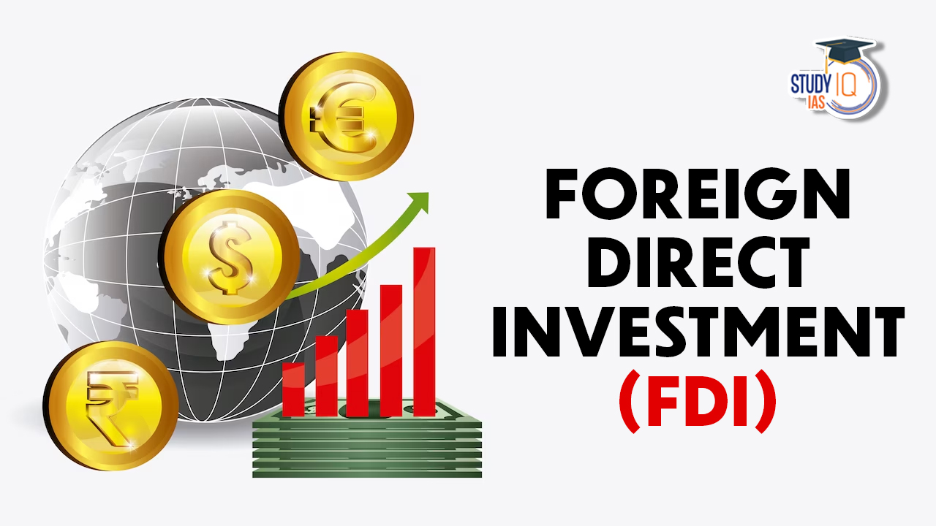
BY: Jai Gajanana Hegde
jaigajananahegde@gamil.com

Slide 2
Problem Statement
Investment is a game of understanding historic data of investment objects under
different events but it is still a game of chances to minimize the risk we apply analytics
to find the equilibrium investment.
To understand the Foreign direct investment in India for the last 17 years from 2000-01
to 2016-17. This dataset contains sector and financial year-wise data of FDI in India
Sector-wise investment analysis Year-wise investment analysis.
Find key metrics and factors and show the meaningful relationships between
attributes. Do your own research and come up with your findings

Slide 3
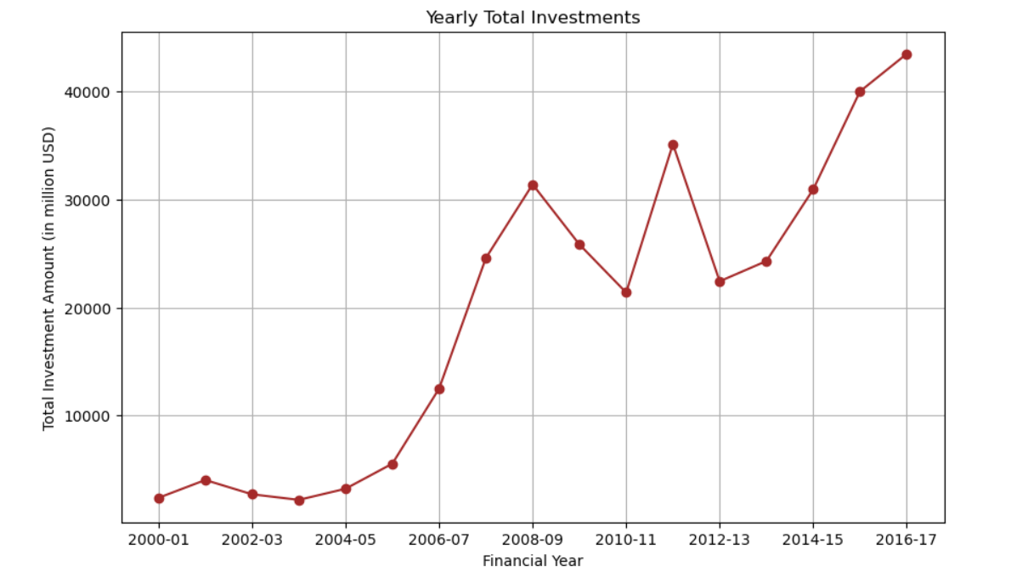
Insights
The line plot shows a significant increase in total FDI in India from 2004-05 to 2008-09, followed by some fluctuations. After a dip around 2012-13, investments have consistently risen, peaking in 2016-17. This indicates an overall positive trend in FDI over the analyzed period.

Slide 4
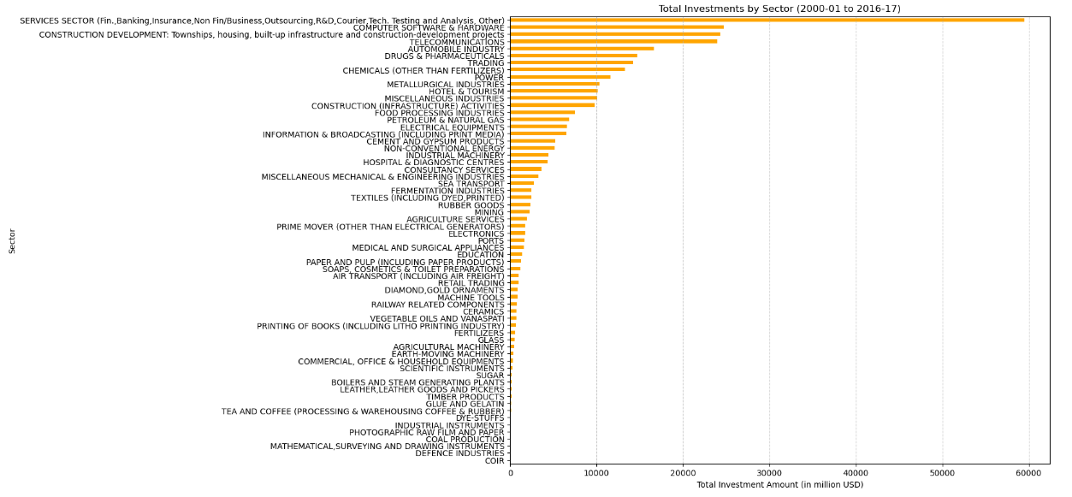
Insights
Key Takeaways
The Services Sector and Construction Development are the biggest attractors of FDI.
Technology and industrial sectors like Computer Software & Hardware and Telecommunications are also major recipients.
Traditional and niche sectors received less investment, highlighting potential areas for policy focus or growth opportunities.
This visualization clearly shows which sectors have attracted the most foreign investment, providing insights into economic priorities and investment trends.

Slide 5
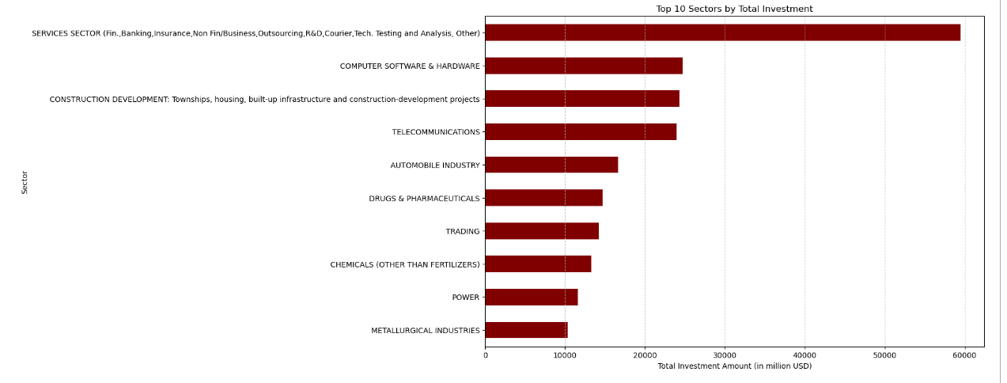
Insights
Key Insights
The Services Sector dominates FDI, showcasing its critical economic role.
Infrastructure and technology sectors attract major investments, reflecting development needs and growth potential.
Healthcare and chemical industries also receive significant investments, indicating their economic importance.

Slide 6
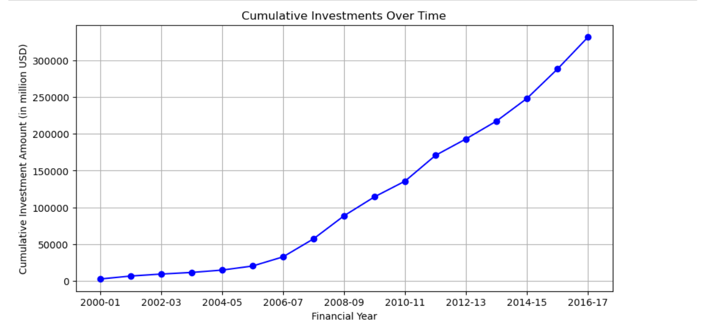
Insights
Overall Insight
The consistent upward trajectory of cumulative investments highlights sustained investor confidence in the Indian market.
The period post-2005 shows a sharp increase in investment inflow, suggesting favorable economic or policy conditions during that time.
This analysis helps investors and policymakers understand the long-term trend of FDI inflows into India, indicating robust and growing foreign investment interest in the country.

Slide 7
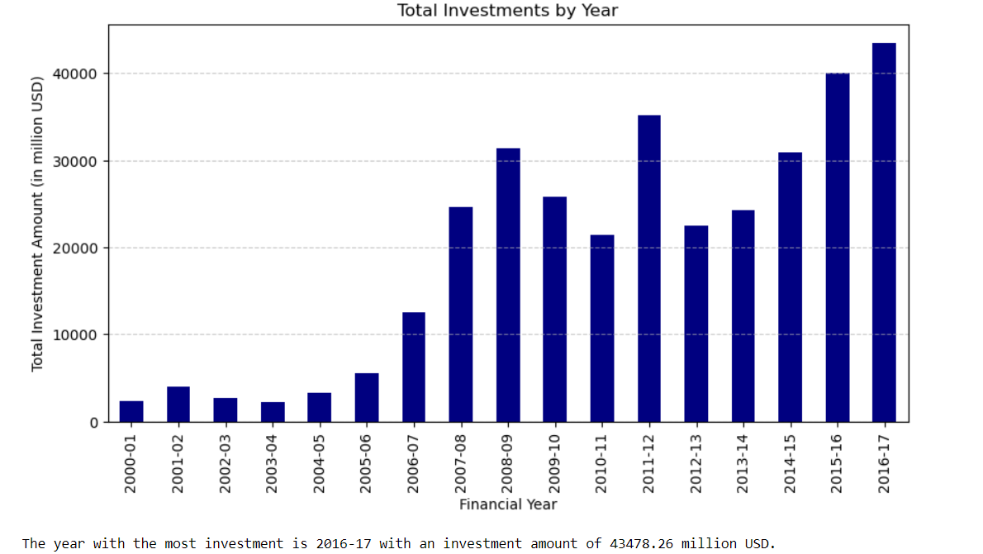
Insights

Slide 8
Conclusion
The analysis of the Investment Concentration Ratio over the years reveals fluctuations in how concentrated FDI investments have been within the top 5 sectors. The trend towards decreasing concentration in recent years indicates positive diversification, which should be further encouraged through targeted policies and incentives. Monitoring periods of high concentration and ensuring balanced growth across sectors will help in sustaining a robust and diversified economic environment attractive to foreign investors.

Slide 9


